Slide 1
Serverless Heart Rate Stream And Batch Processing Architecture
SDCC project 2024/25
Greta Luna Ancora 0369455 Nicola Violante 0362469

Slide 2

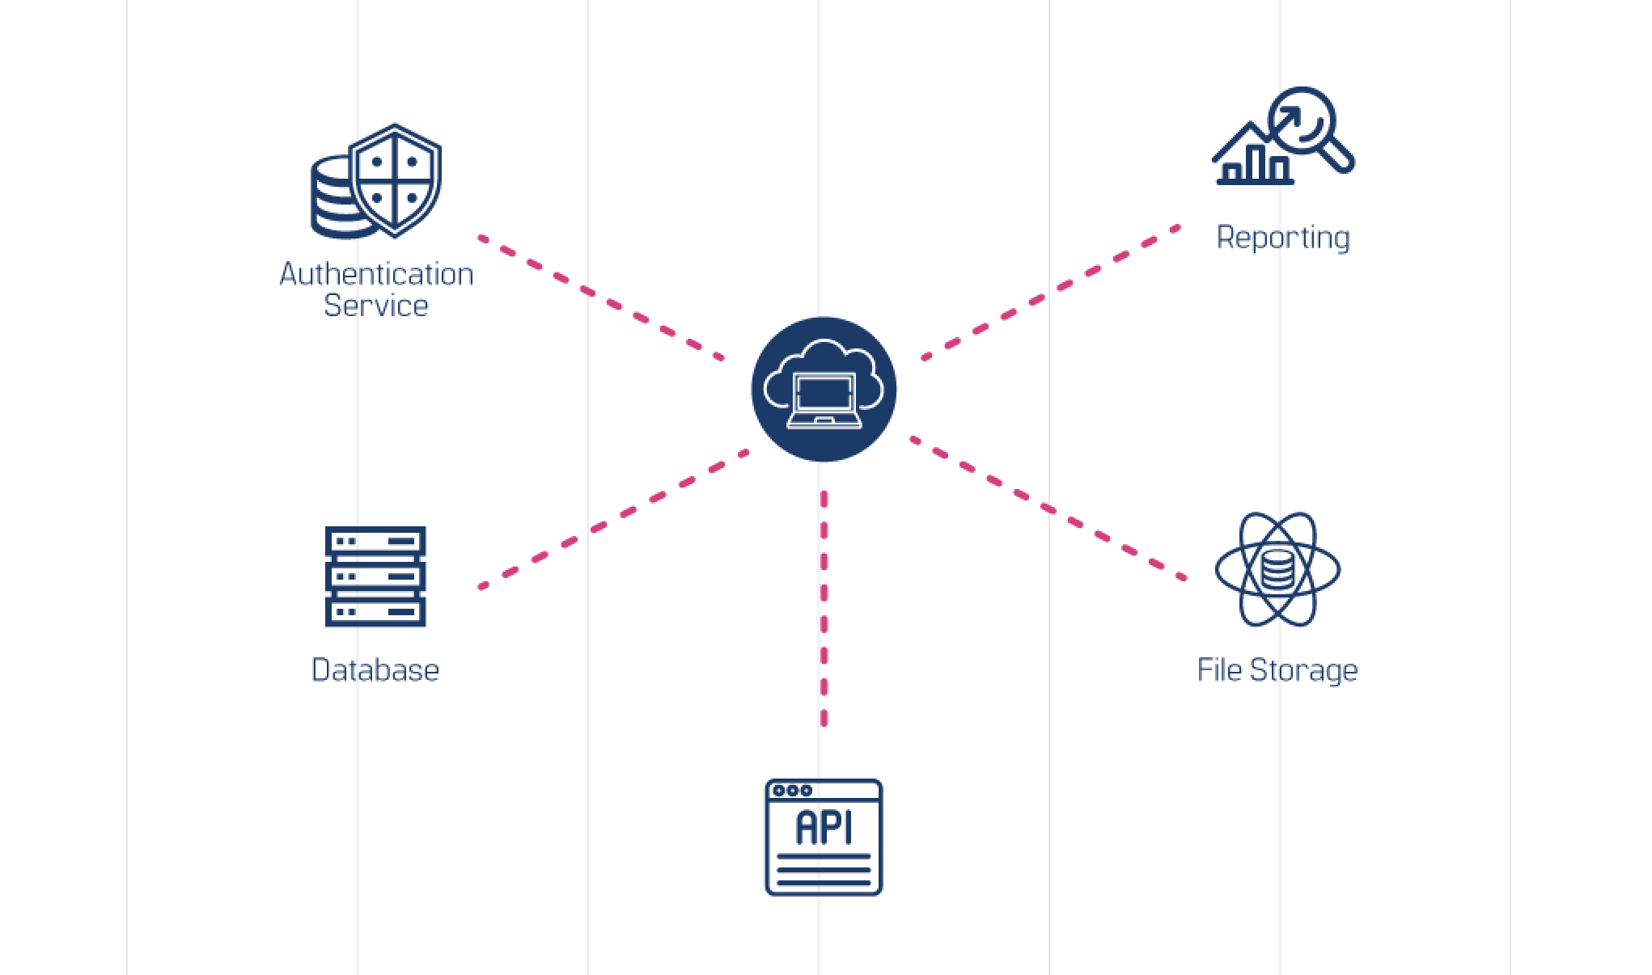
About the project
The ever-wider adoption of pervasive devices—such as health trackers, medical wearables, and smartwatches—has enabled large-scale telemedicine and health monitoring, allowing real-time detection of clinical anomalies
Our work focuses on adopting a serverless architecture to develop a software application capable of managing data streams generated by IoT devices, analyzing them in real time, and making them immediately available to physicians and patients

Slide 3
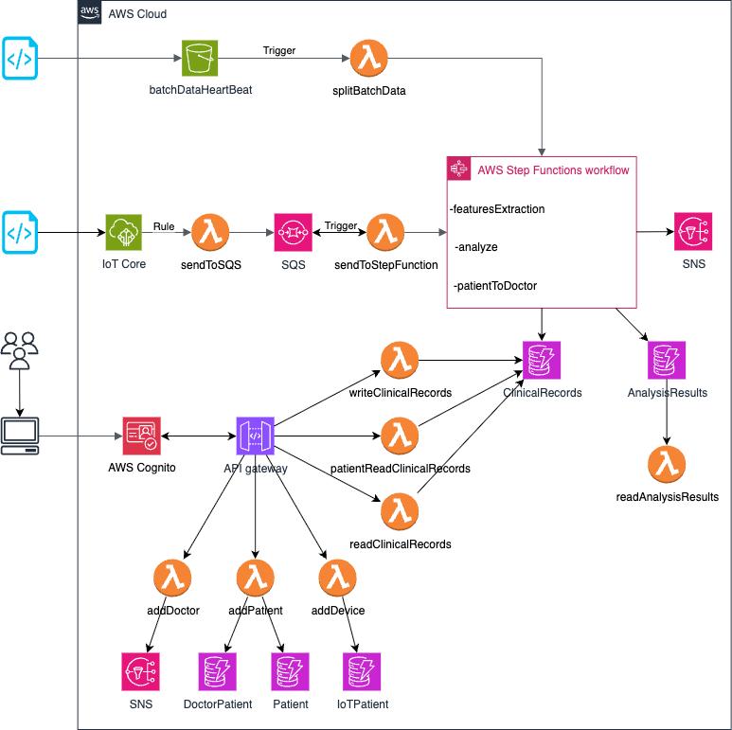
System architecture
Microservices
Remote data analysis (both stream and batch mode)
Clinical records managements
Doctors and patients managements

Slide 4

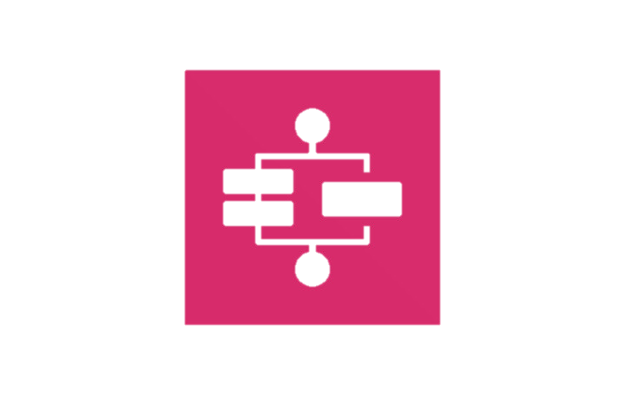
AWS Lambda and AWS Step Function
AWS Lambda: used to implement the application logic of our system
addDevice, addDoctor, addPatient
checkAdminGroupAuth, checkDoctorGroupAuth, checkPatientGroupAuth, login
readClinicalRecords, writeClinicalRecords
readAnalysisResults
sendToSQS, sendToStepFunction
splitBatchData
AWS Step Function: used to create workflows
featuresExtraction
Analyze
patientToDoctor

Slide 5

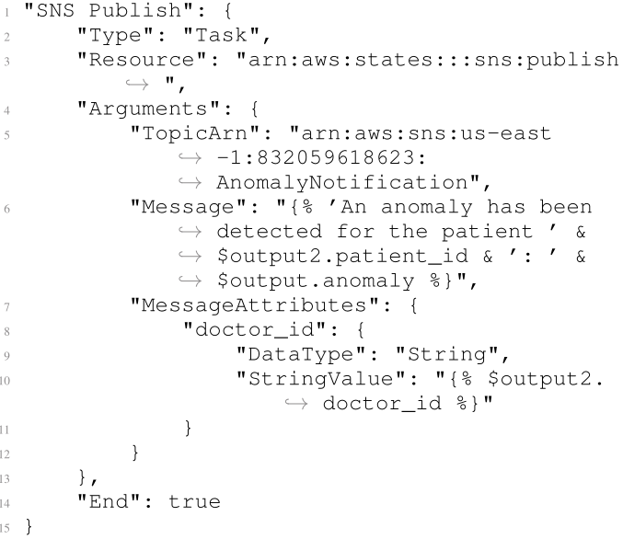
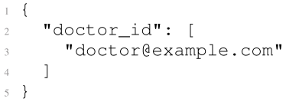

AWS Simple Notification Service (SNS)
To send alerts to Doctors
Anomaly notification topic

Slide 6

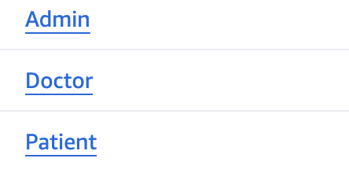
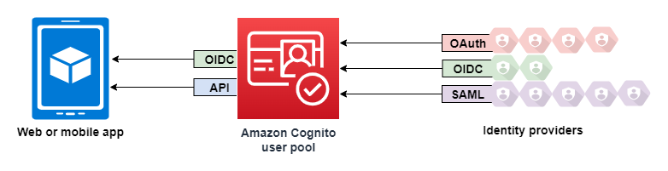
AWS Cognito
Authentication through JWT
Authorization through JWT in combination with Lambda Authorizers
Three Groups: Admin, Doctor and Patients

Slide 7
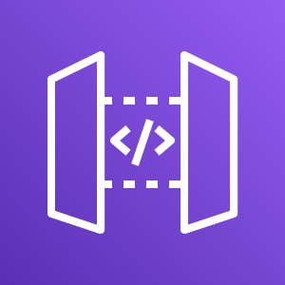
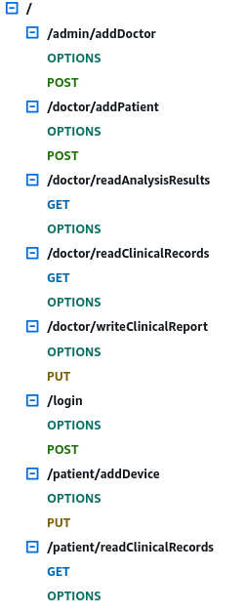
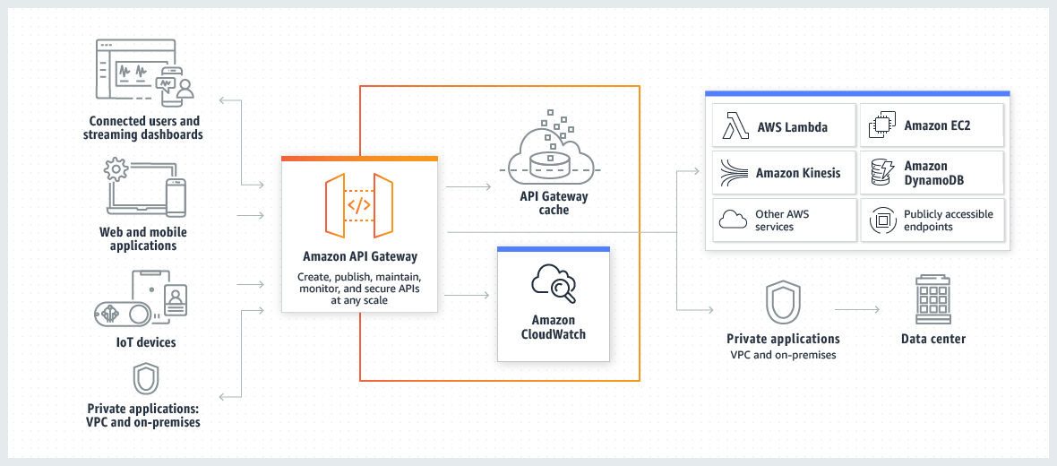
AWS API Gateway
To implement RESTful API
Lambda proxy integration
CORS integration
Lambda Authorizers

Slide 8

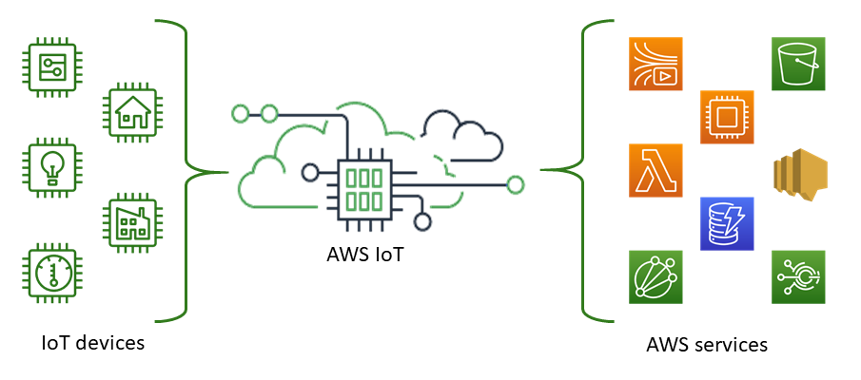
AWS IoT Core
To connect IoT Devices to the cloud services
Things
Certificates X.509
Policies
IoTSimulator/bmp topic
Triggers sendToSQS

Slide 9

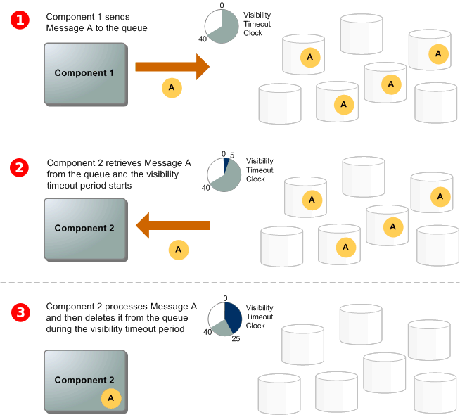
AWS Simple Queue Service (SQS)
To ingest data streamed from IoT devices
Message queue benefits
FIFO queue
Batch processing

Slide 10

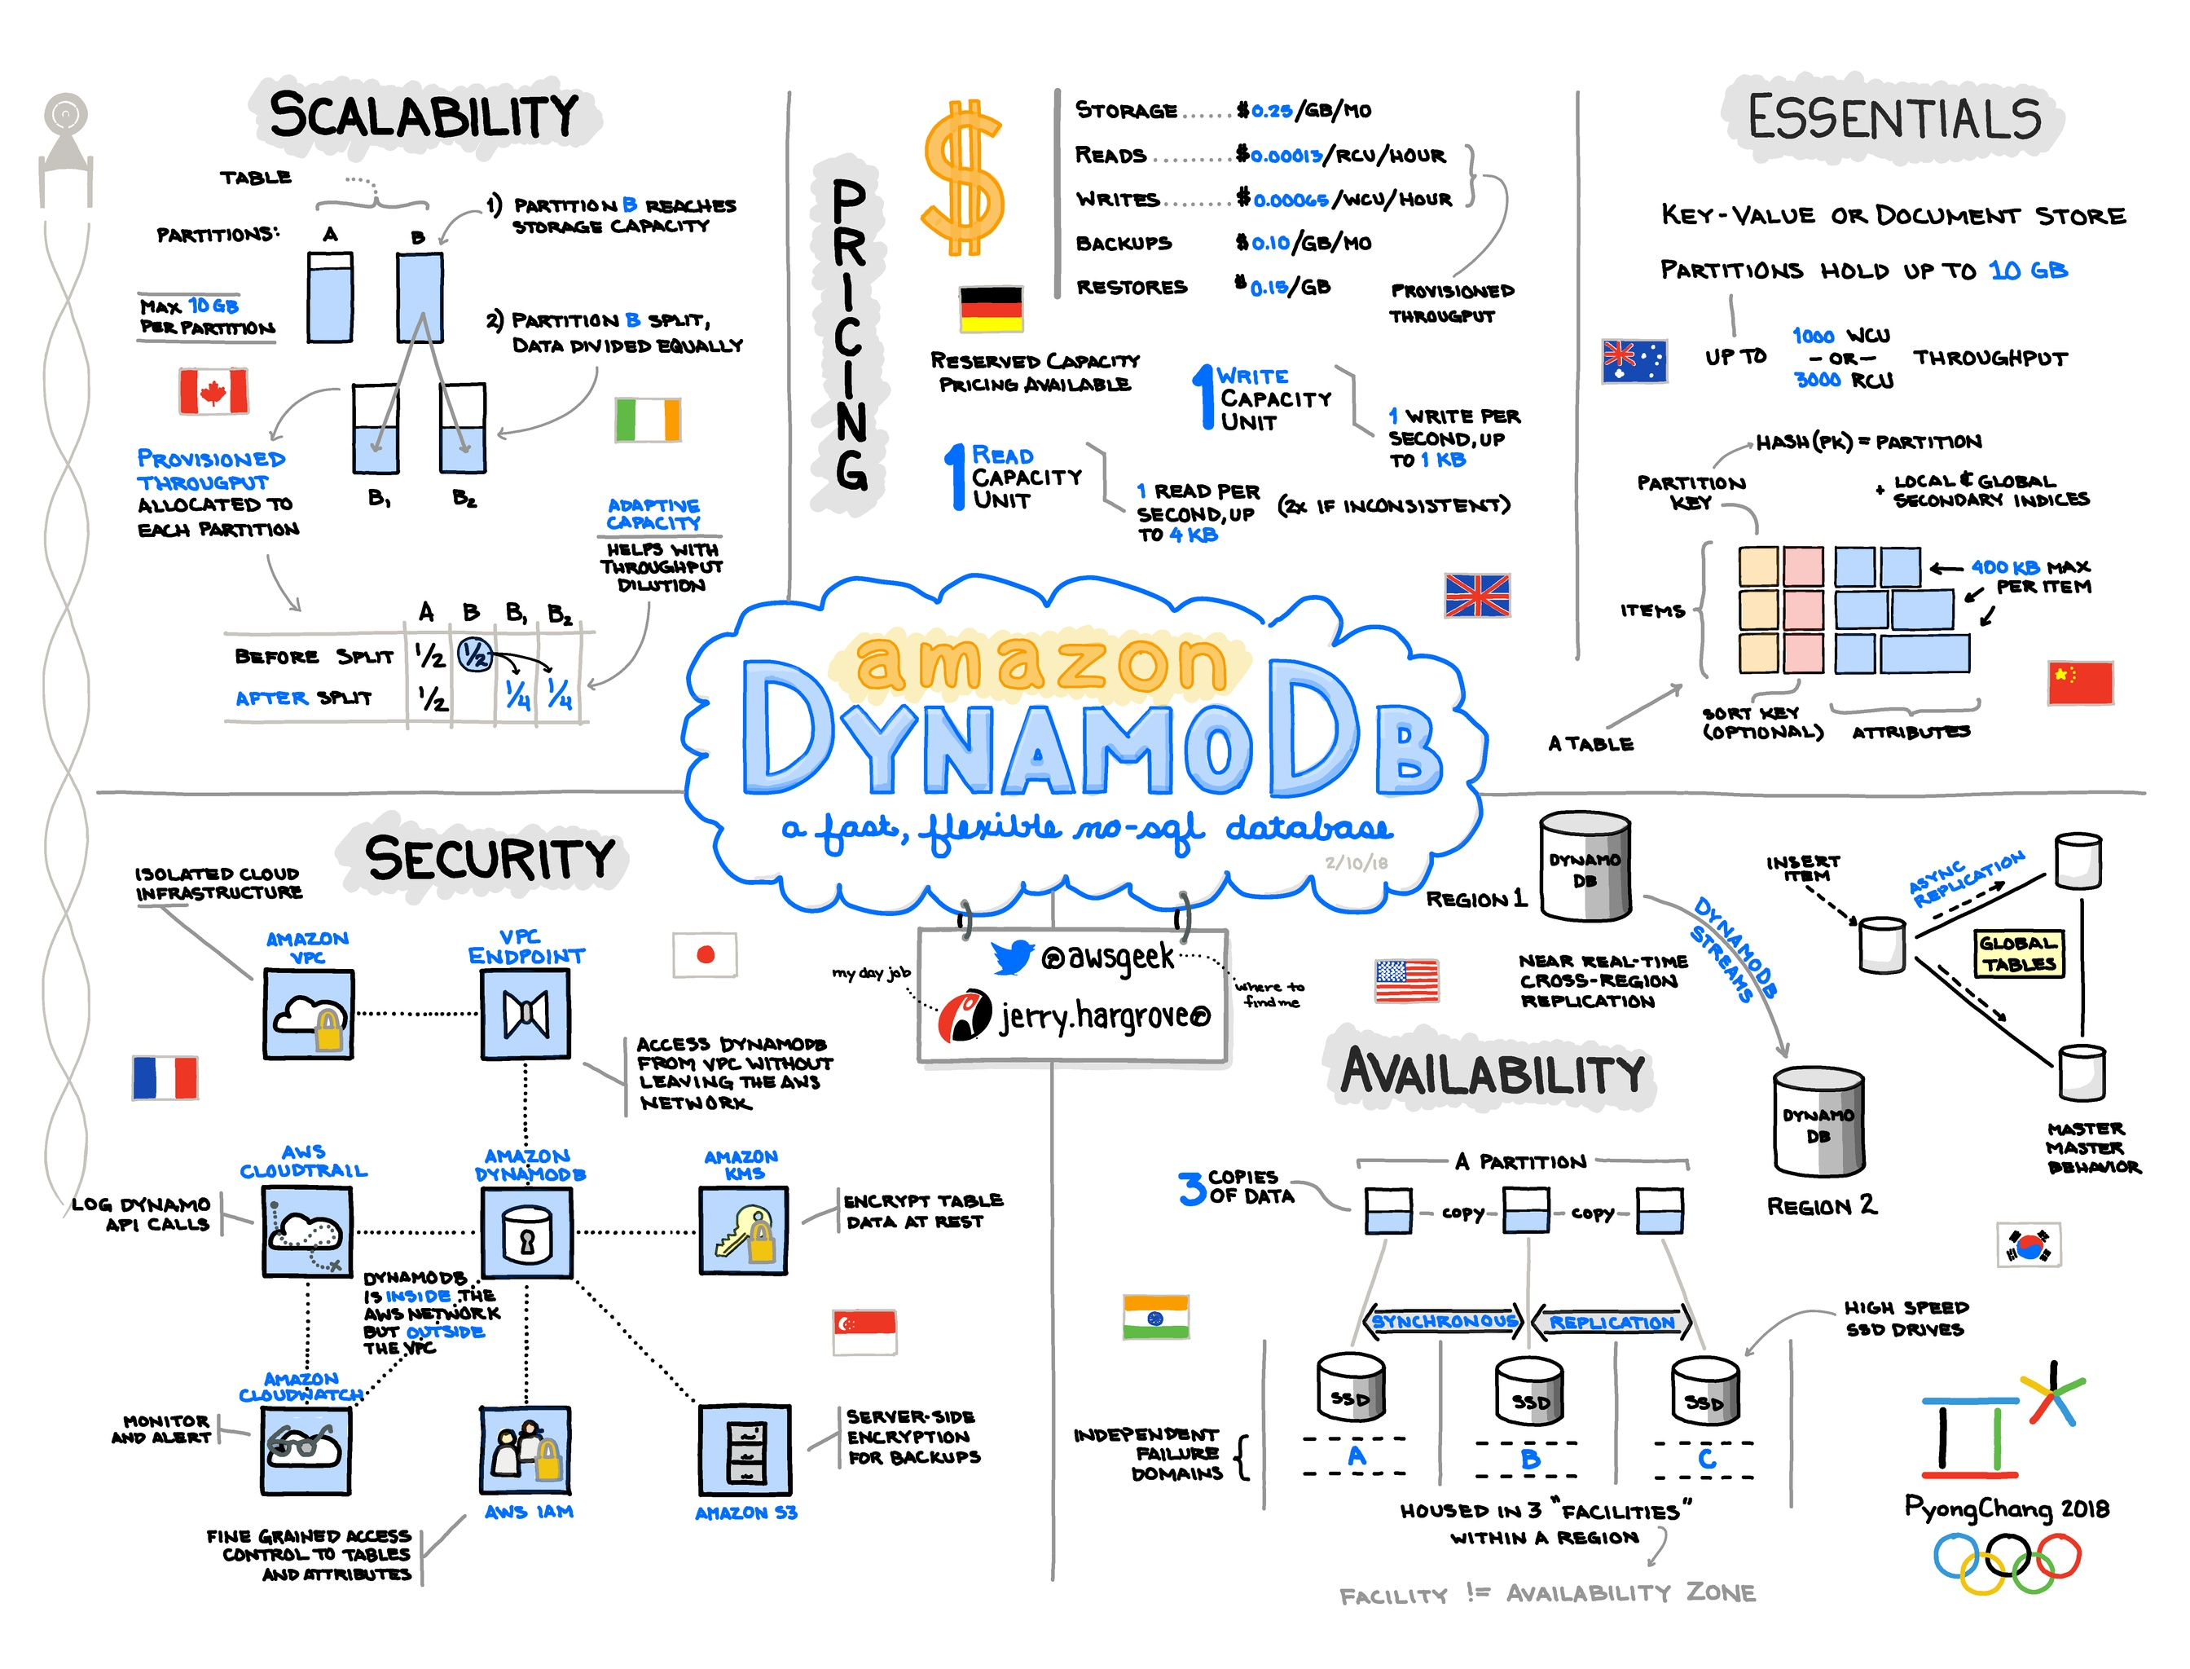
AWS DynamoDB
To store in a persistent way data
Tables: AnalysisResults, ClinicalRecords, DoctorPatient, IoTPatient, Patient

Slide 11

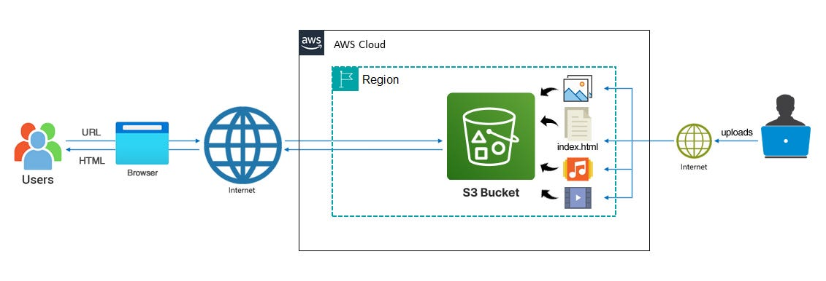
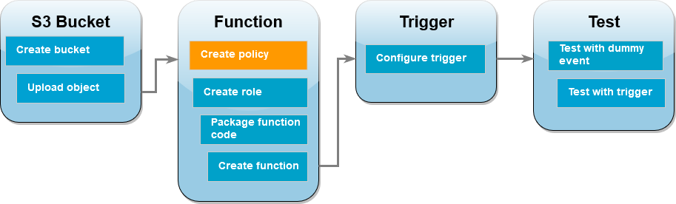
AWS Simple Storage Service (S3)
To store and protect data
Bucket: batchdataheartbeat, frontendheartbeat

Slide 12
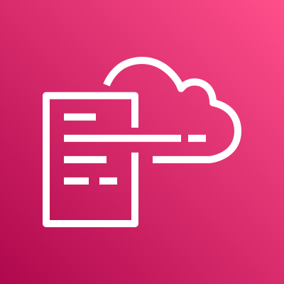
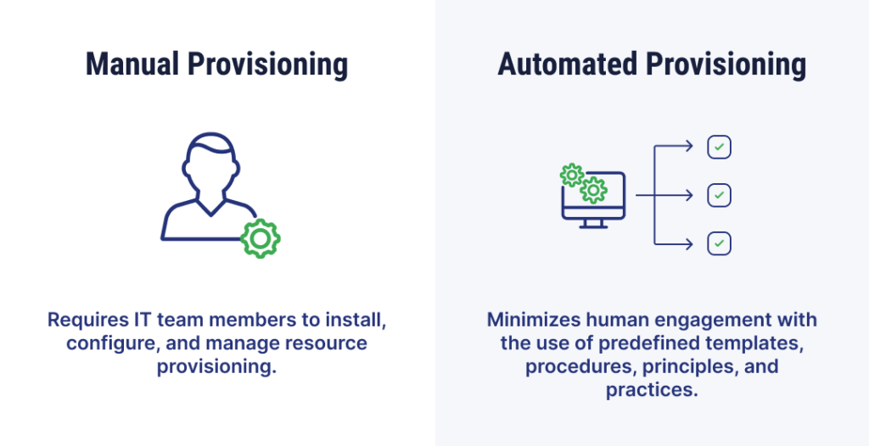
AWS CloudFormation
To distribute application code and configuration settings
IaC generator
Template: CognitoTemlate, RestAPITemplate, BatchBucketTemplate, HeartBeatTemplate

Slide 13

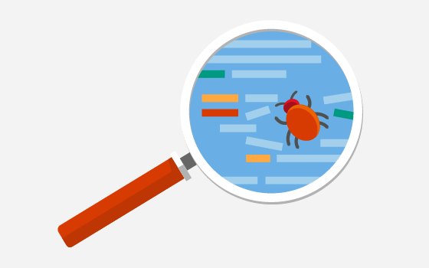


AWS CloudWatch
To monitor resources
To debug application code

Slide 14



Conclutions
AWS SageMaker to implements more advanced processing mechanism
Terraform
AWS Amplify Hosting to automatically propagate and deliver code changes

